Slide 1
Group 2 Project Presentation

Slide 2
Project Objective
Our goal was to identify trends of food purchases relative to recipe searches, trends in food delivery services and general trends in eating in vs. dining out in the US.
The main questions we wanted to address were:
What are the broad trends in grocery/food store sales vs. restaurant/dining sales during 2020 vs. longer periods of time?
Was there evidence to support these trends on an individual company basis?
Was there any relationship between food at home vs. food away from home?
Was there any relationship between food delivery service data and grocery sale trends?

Slide 3
Sources of Data
USDA
US Census Bureau
SEC public filings
Open Table
Google Trends
COVID Tracking Project
Business of Apps

Slide 4
What are the broad trends in grocery/food store sales vs. restaurant/dining sales during 2020 vs. longer periods of time?

Slide 5
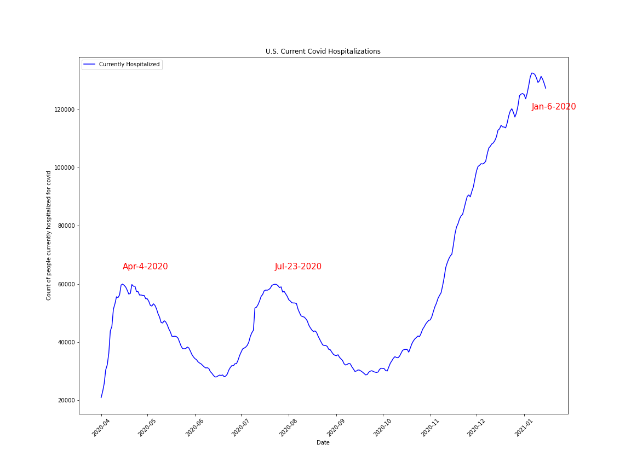
Covid Hospitalization from Covid Tracking Project
Most recent Covid Tracking Project Covid-19 U.S. Current Covid Hospitalizations data was downloaded in .csv form from covidtracking.com
Minimal dataframe cleanup was necessary for the plot
Local maxima were determined using .max() function and .loc
Peak dates of hospitalization were used as a comparison to other data

Slide 6
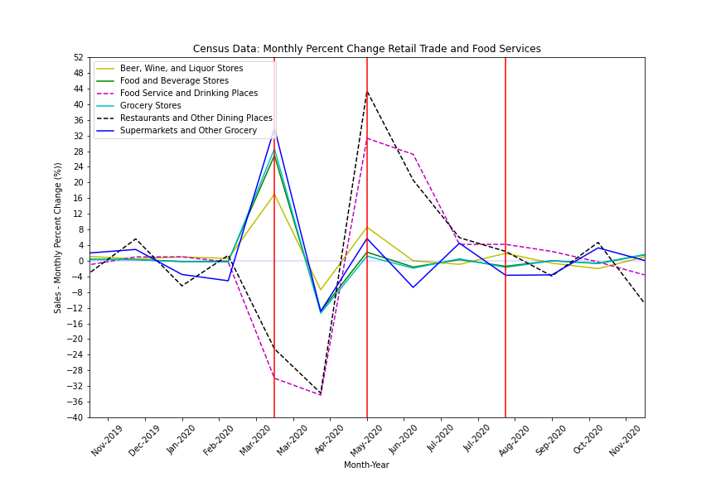
U.S. Monthly Retail Trade and Food Service Data from Census.gov
Census conducts monthly business surveys and data is available at census.gov
Total sales (in millions of dollars) and monthly sales percentage change is available
Multiple data sets were downloaded in .csv form from available time frame (Jan-2017 to Nov-2020)
Clear trend is visible around pandemic onset in the U.S.
Red vertical lines indicate points of interest
Additional hospitalization maxima do not appear to correlate
Indicates Late-July 2nd covid hospitalization maximum
March 2020 sees expected increase and decrease of stores and restaurants, respectively
May 2020 sees rebound of restaurants and food service places

Slide 7
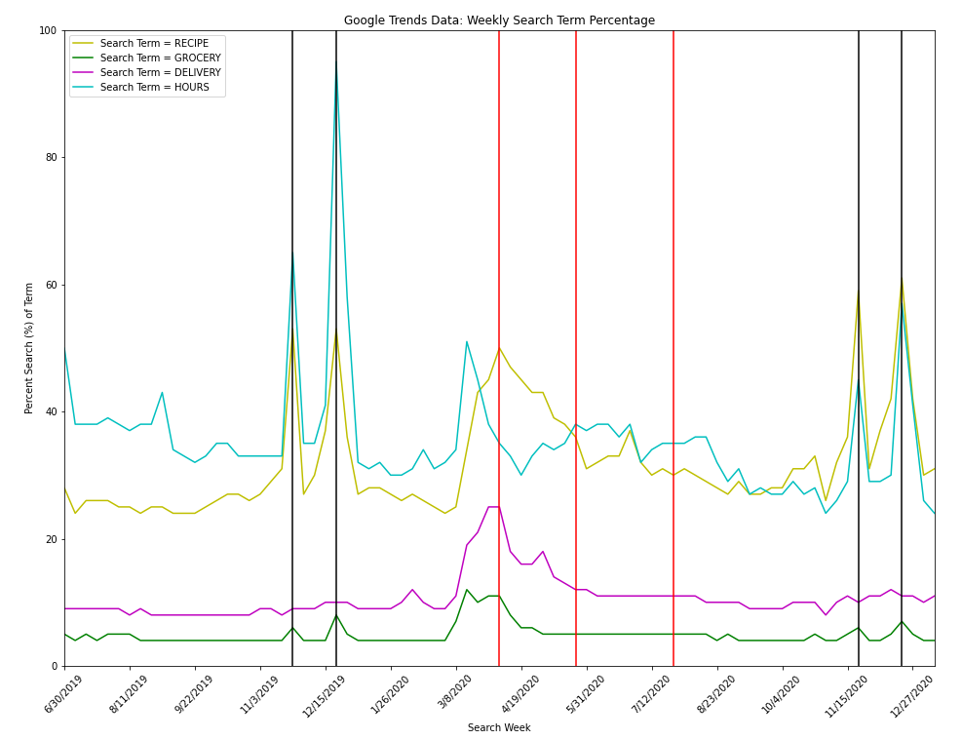
Google Search Trends
Google search trend data is downloadable in .csv form from trends.google.com
Four food/grocery/restaurant related terms were compared in the U.S. for the last 5 yrs: RECIPE, GROCERY, DELIVERY, and HOURS
Data required minimal clean up; two distinct peaks corresponding to approximate date of Thanksgiving and Christmas were visible.
Similar to census data, search terms spiked with onset of pandemic but primarily do not follow hospitalization features.
HOURS shows some additional features, but likely within pre-pandemic baseline.
Indicates Late-July 2nd covid hospitalization maximum
Double peaks correspond to Thanksgiving and Christmas (not seen for DELIVERY)
4/5/2020
5/24/2020

Slide 8
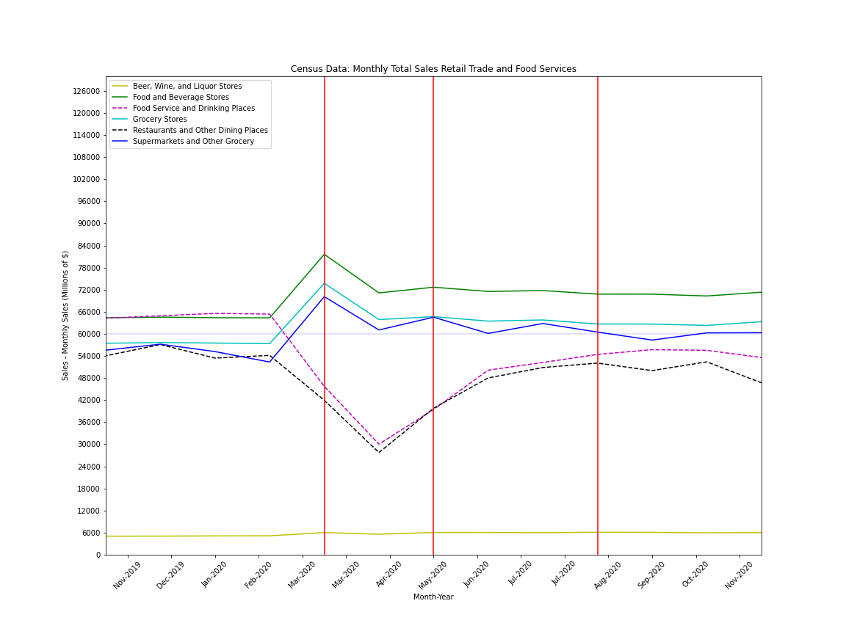
Extra
Monthly total sales in millions of dollars

Slide 9
Was there evidence to support these trends on an individual company basis?

Slide 10
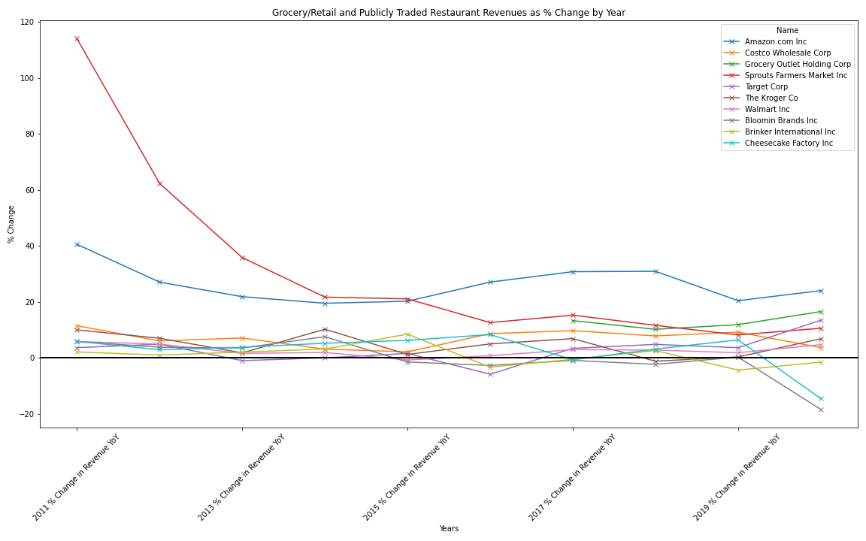
Individual Company Trends
I chose several publicly traded grocery chains (Kroger, Sprouts Farmers Market, Grocery Outlet), large multi-channel retailers (Costco, Target, Walmart) and Amazon, as they acquired Whole Foods several years ago.
I also chose 3 publicly traded restaurant chains, Bloomin Brands (Outback, Carrabba’s, Bone Fish Grill, Fleming’s), Brinker International (Chili’s and Maggiano’s) and Cheesecake Factory.
After compiling the data into a .csv file, I brought the data into a dataframe in pandas and began to clean the formatting.
To estimate full year 2020 revenue data, since most companies have not announced their earnings data yet, I had to make a pro-forma estimate of full year 2020 revenue using TTM revenue numbers and then projecting using Q1 – Q3 revenue numbers which gave me a rough estimate for what Q4 would look like and then rolled all four quarters into an annual estimate for 2020.
After cleaning the revenue data, I made a calculation for the percentage change year over year and created a new dataframe with that information.
Lastly, I plotted the year over year percentage change in revenue to visualize the data graphically, focusing on the divergence between grocers and publicly traded restaurants. As you can see, many of the grocers maintained or actually grew their revenues faster than they had on a trending basis, while the publicly traded restaurant revenues fell off a cliff in 2020.

Slide 11
Was there any relationship between food at home vs. food away from home?

Slide 12
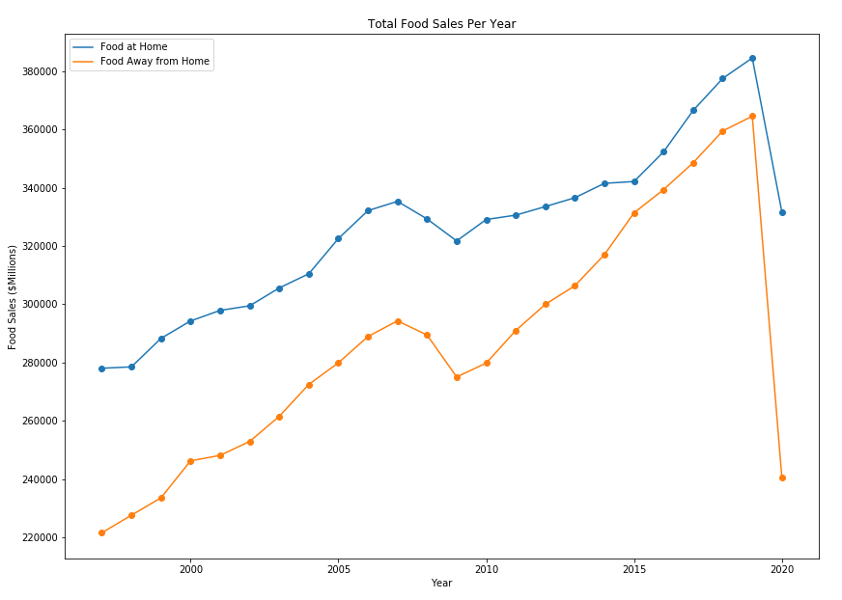
There is a drastic drop in sales for Food Away from Home in 2020
Data was downloaded from USDA for 1998-2020 as excel files, and converted to csv for ease of reading in
“Food at Home” refers to any food purchased at a grocery store and taken home to prepare/consume
“Food Away from Home” refers to any food purchased from restaurants
*2020 data only includes January - October

Slide 13
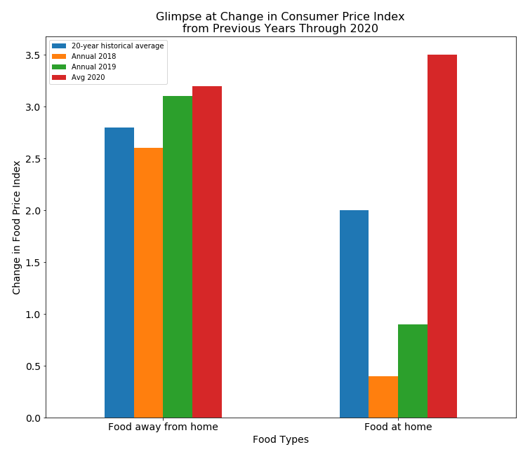
Food prices increase substantially for food at home items
Average 2020 because data does not include the entire year (data was collected in December, so does not include the entire year)

Slide 14
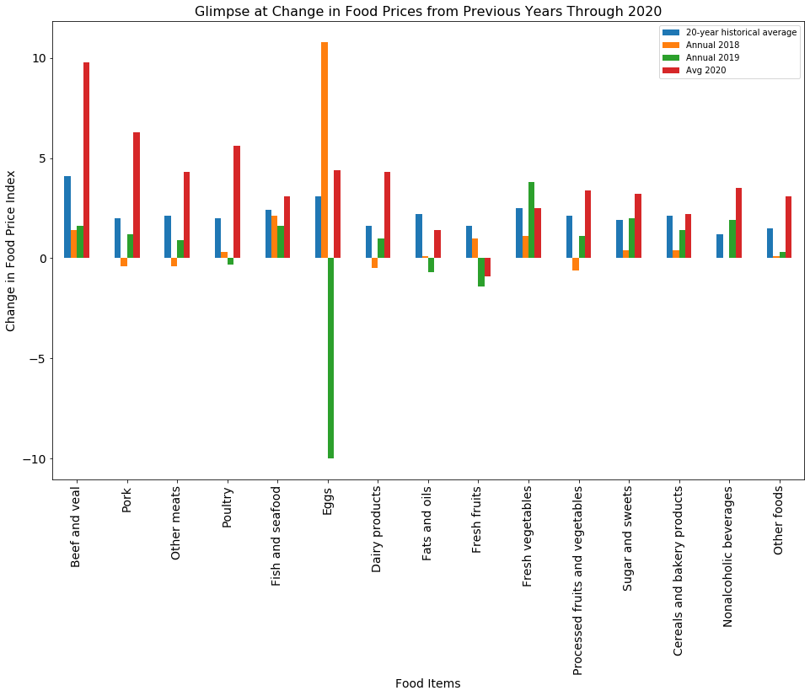
Prices increase for several grocery items
Items are more expensive for all items except fresh fruit and fats/oils

Slide 15
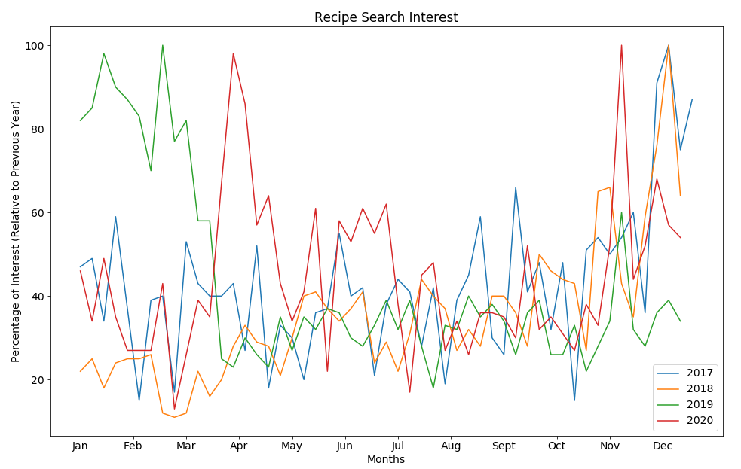
Recipe searches show some spikes in unexpected months of the year
Data from Google Trends
Number of searches higher in months that are not typically peak months for recipe searches

Slide 16
Was there any relationship between food delivery service data and grocery sale trends?

Slide 17
What were the trends we see in the delivery service and restaurant diners during covid?
W

Slide 18
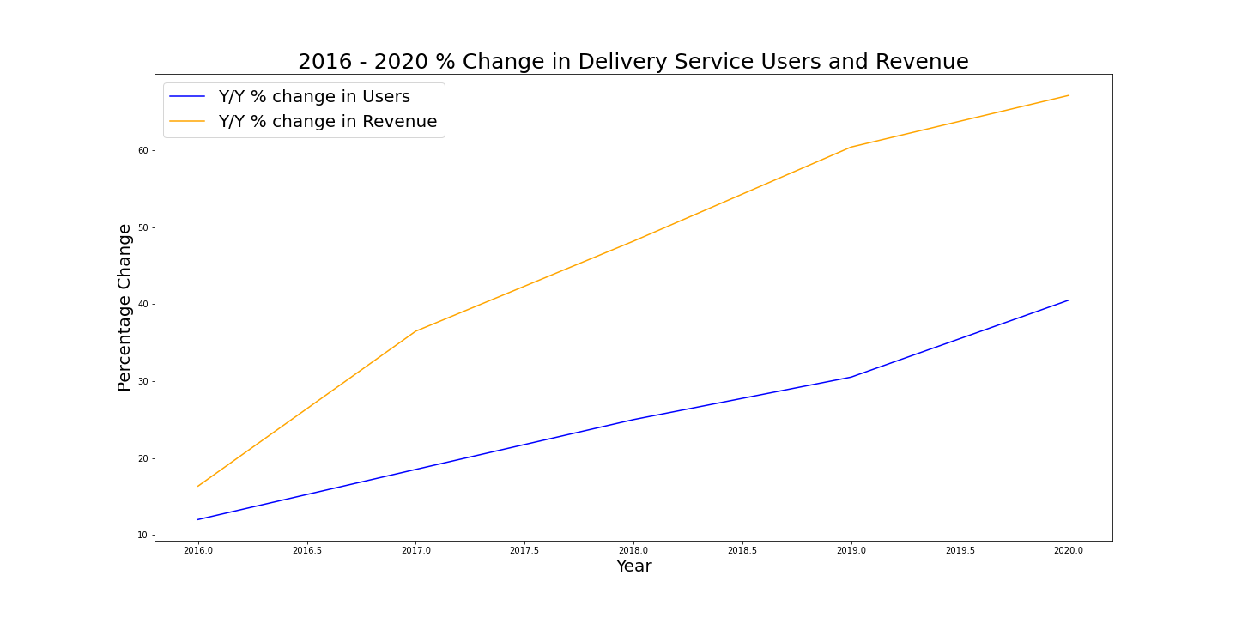
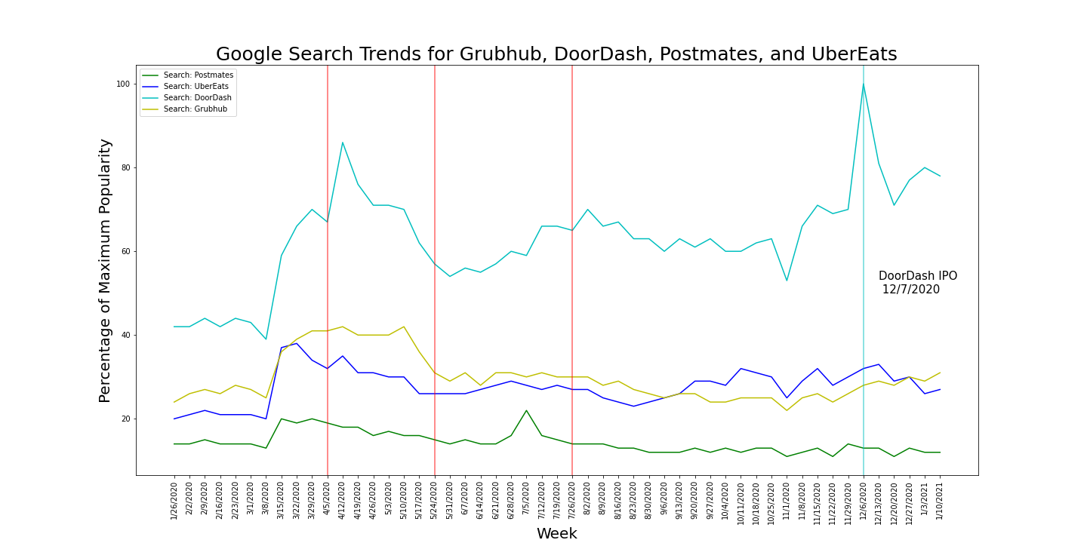
Delivery Service Trends
We used the data from Business of Apps to assess the aggregate (all delivery apps) change in YoY revenue and users. We found that both percentage change from 2019 to 2020 increased, with user changed at an increasing rate. We then used Google Trend data to assess the search of the individual trends of the big four companies: UberEats, Postmates, DoorDash, and Grubhub. We plotted the same important date markers as before.

Slide 19
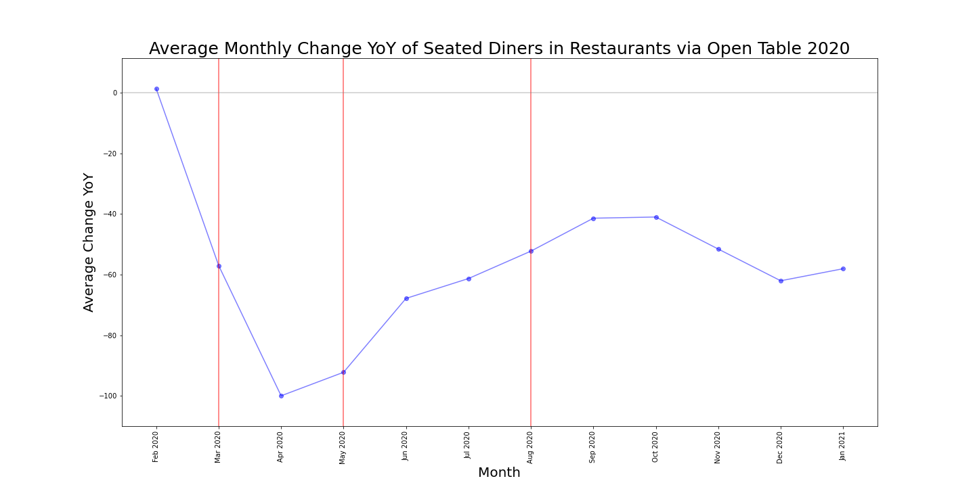
Using OpenTable’s 2019-2021 data we calculated the average monthly YoY percentage change in in-restaurant diners. We can see the trends are congruent with our findings that in March we see the biggest increase in percentage change, May 2020 is the rebound, and Aug 2020 we see an increase in the YoY percentage when we have our 2nd covid hospitalization maximum.

